Slide 1
Vertebrate Beginnings
The Chordates

Slide 2
Phylum: Chordata
Derives from the name notochord
Noton - back + chorda – cord
Five characteristics that set chordates apart from other phyla
Notochord
Single, dorsal, tubular nerve cord
Pharyngeal pouches or slits
Endostyle
Always found at some embryonic stage
May be altered or disappear in later stages of life

Slide 3
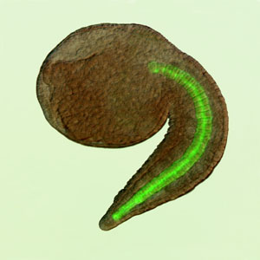
Phylum Chordata
Notochord
A flexible rodlike structure that forms the main support of the body
first part of the endoskeleton to appear in the embryo
axis for muscle attachment
Most protochordates & jawless vertebrates, it persists throughout life
Replaced in jawed vertebrates (in whole or part) by cartilage or bone vertebrae
In mammals slight remnants are found in intervertebral discs

Slide 4
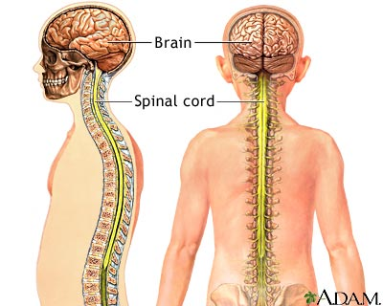
Phylum Chordata
Single, dorsal, tubular nerve cord
runs from anterior to posterior.
anterior end becomes enlarged to form the brain

Slide 5
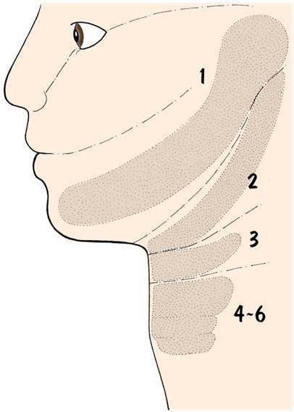
Phylum Chordata
Pharyngeal Pouches & Slits
Openings that lead from the pharyngeal cavity to the outside
Slits form in pharynx in aquatic chordates which form filter feeding apparatus in protochordates
Fishes added a capillary network which eventually evolved into gills
In amniotes, grooves do not penetrate into pharynx

Slide 6
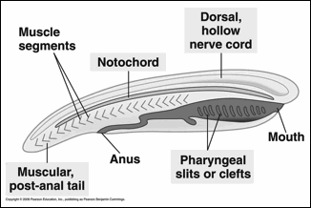
Phylum Chordata
Postanal Tail
Extends beyond anal opening
Often used in locomotion
May be modified or reduced
(e.g., human coccyx)

Slide 7
Phylum Chordata
Some biologists consider the endostyle a fifth chordate feature
True endostyles are found in urochordates, cephalochordates, and lamprey larvae
Produces mucus which aids in movement of food from the pharynx to the esophagus
Some cells within the endostyle secrete iodinated proteins
similar to the thyroid gland in vertebrates
Endostyles or thyroid glands occur in no other animal phylum but Chordata

Slide 8
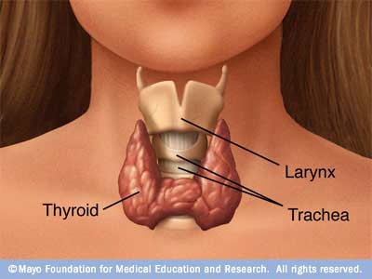

Slide 9
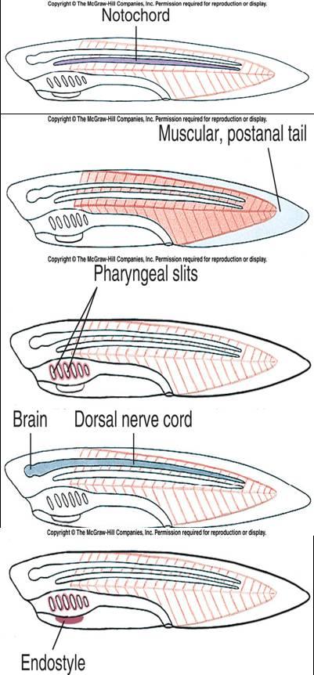

Slide 10
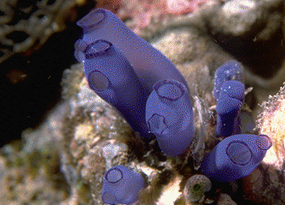
Subphylum Urochordata
Diversity
3000 species found in all seas and all depths
Larvae bear the chordate characteristics but lose all but pharyngeal slits as adults, which are sessile
Ascidians--sea squirts live on rocks, pilings in intertidal areas and are filter-feeders
Thalacians—salps live in open-ocean and filter-feed
Larvacea—resemble larval forms of tunicates and filter-feed

Slide 11
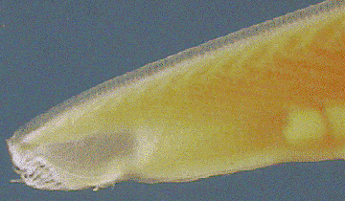
Subphylum Cephalochordata
Characteristics
Lancelets (amphioxus) are slender, laterally flattened, translucent animals about 5-7 cm. Long
Live in sandy bottoms of coastal areas around the world

Slide 12
Subphylum Cephalochordata
Form & Function
Filters water through pharyngeal slits
Closed circulatory system without heart
Nerve cord above notochord
Considered living descendant of ancestors that produced cephalochordates and vertebrates

Slide 13
Subphylum Vertebrata
Characteristics
Endoskeleton
Grows with individual, jointed to allow scaffolding for muscles
Skull and rib cage enclose and protect organs
Tough integument also protect individual
Cartilage probably 1st endoskeleton material because it promotes fast growth; remains in sharks
Bone can store minerals and has added strength needed for terrestrial life

Slide 14
Subphylum Vertebrata
Pharynx & Efficient Respiration
As protovertebrates shifted from filter feeders to predators, pharynx modified into muscular feeding apparatus that could pump water
Circulation in internal gills improved with addition of capillary beds and aortic arches, which increased metabolic rate

Slide 15
Subphylum Vertebrata
Advanced Nervous System
Switch to predation created selective pressure for paired eyes with lenses and inverted retinas, pressure receptors, paired ears, electroreceptors, and chemical receptors
new vertebrate innovations in cells (extremely rare event in evolution)
resulted in cranium, cranial nerves, branchial skeleton, and aortic arches; also give rise to nose, eyes, ears, taste receptors, and lateral line mechanoreceptors

Slide 16
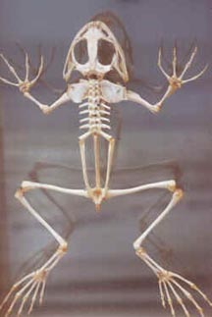
Subphylum Vertebrata
Paired Limbs
Pectoral and pelvic appendages originated as swimming stabilizers
Jointed limbs that developed are suited for life on land and permit fine movement

