Slide 1
Excretory System

Slide 2
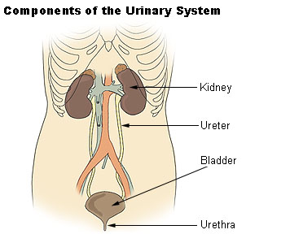
Structure
Paired kidneys
Ureter for each kidney
Urinary bladder
Urethra

Slide 3
Anatomy
Kidney
One of two bean-shaped organ behind the abdominal cavity
Outer cortex region
Inner medulla region
Hilum: depression on the medial border. Blood vessels & nerves pass through the hilum
Ureter (2)
Muscular tubes that carry urine in peristaltic waves from the kidneys to the urinary bladder
Urinary Bladder
Hollow, muscular sac, temporary reservoir for urine
Urethra
Tube that carries urine from the bladder outside the body
Urination or voiding: expelling urine

Slide 4
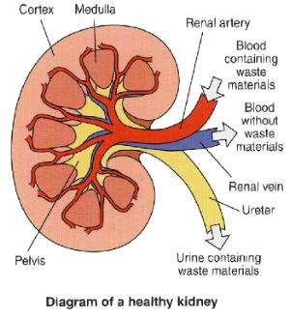

Slide 5
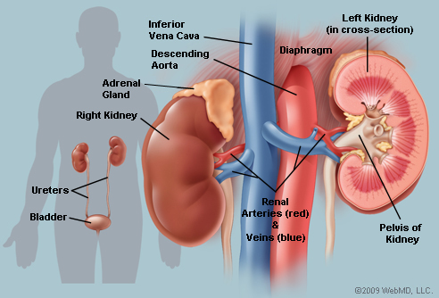

Slide 6
Function
Removes nitrogenous wastes from the blood
Urea, creatinine, & uric acid
Kidneys
Filter the blood to remove nitrogenous wastes
Maintain the proper balance of water, electrolytes, & acids
Electrolytes such as Na⁺ & K⁺
Secrete renin (raises blood pressure) & erythropoietin (stimulates red blood cell production)

Slide 7
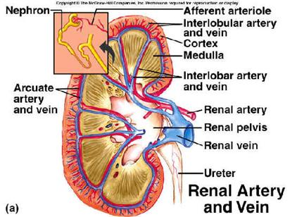

Slide 8
Physiology: How the Kidneys Produce Urine
Blood enters kidney through Renal Arteries at the hilum
Branches into smaller & smaller arteries
Smallest arteries are arterioles
Nephron: combination of glomerulus & renal tube
Each arteriole leads to glomeruli (singular glomerulus)
Intertwined smaller blood vessels
Each glomerulus filters the blood
Permit water, salts, sugar, & urea to leave bloodstream
Glomerular (Bowman) capsule collects the material
Renal Tubule
Collecting tube; allows reabsorption of water, sugar, & some salts

Slide 9
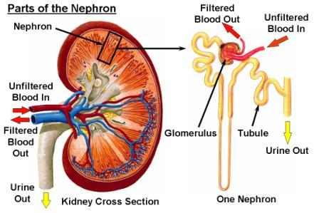

Slide 10
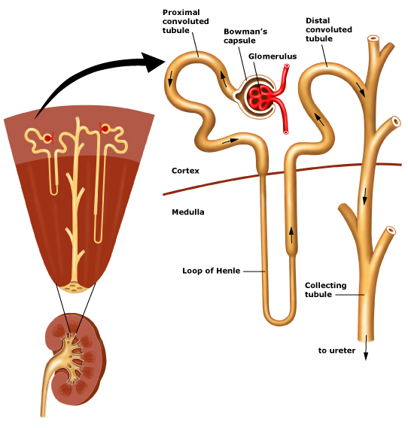

Slide 11
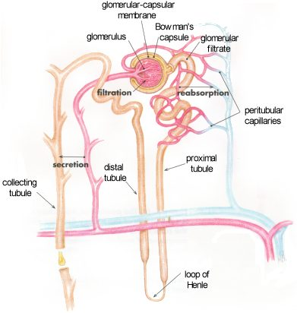

Slide 12
http://www.youtube.com/watch?v=glu0dzK4dbU

Slide 13
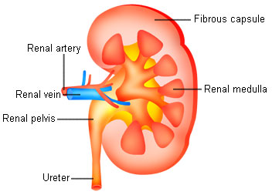
Physiology: How the Kidneys Produce Urine
All collecting tubes lead to the Renal Pelvis
Calyces - Cup like regions
Renal Pelvis narrows into the Ureter
Ureter
carries urine to the urinary bladder
Urinary Bladder
temporarily stores urine
Urethra
Releases urine

Slide 14
Urinalysis – examination of urine
Color
Normal: yellow or straw-colored
Colorless/pale indicates large amount of water
Smokey-red/brown indicates large amount of blood
Beets & certain drugs also produce red
Appearance
Should by clear;
Cloudy or turbid indicates UTI with pyuria & bacteriuria
pH
Normal 6.5
Glucose
Sugar not normally found in urine. Detection may indicate diabetes mellitus
Phenylketonuria (PKU)
Lack of enzyme to accumulate phenylalanine to reach high levels in infants bloodstream which leads to mental retardation

Slide 15
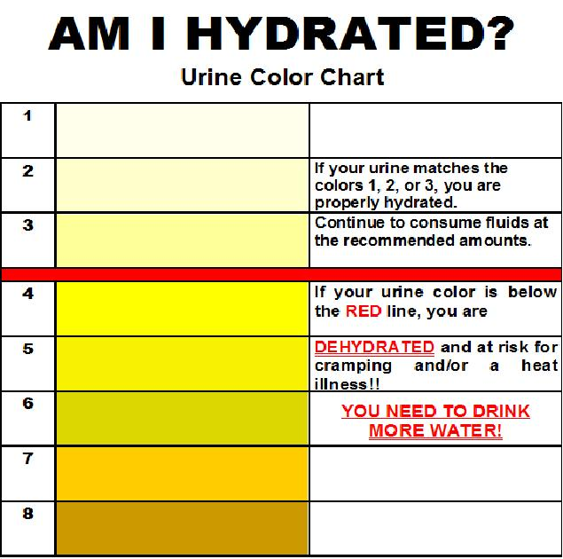

Slide 16
Disorders of the Urinary System
Can you guess one?

Slide 17
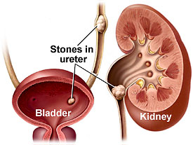
Renal Calculi (Kidney Stones)
Made of crystals of calcium phosphate and uric acid
Gradually they get larger until they block ureters
First symptom: severe pain
Other symptoms:
nausea and vomiting, frequency, chills, fever, hematuria
Treatment
increase fluids to flush out stone, medications, and if needed LITHOTRIPSY

Slide 18
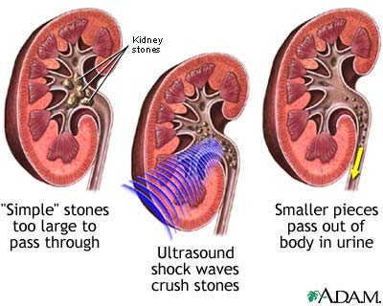
Lithostripsy
Surgical procedure to remove kidney stones
Shock waves hit dense stones and break them up

Slide 19
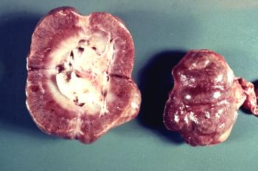
Nephritis
Inflammation of the kidney (kidney infection)
Incontinence –involuntary urination

Slide 20
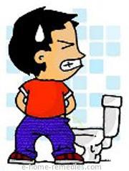
Cystitis
Inflammation of the mucous membrane lining of the urinary bladder
Most common cause – E.Coli
Symptoms - DYSURIA (painful urination) and frequency
Usually in females
(shorter urethra)
Rx - antibiotics

Slide 21
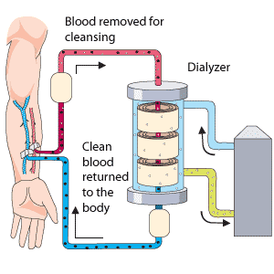
Hemodialysis
Used for kidney failure
Involves the passage of blood through device with semi-permeable membrane
Dialysis serves as substitute kidney
Blood from patient flows through machine and is filtered
Takes 2-4 hours, 2-3 times a week.

Slide 22
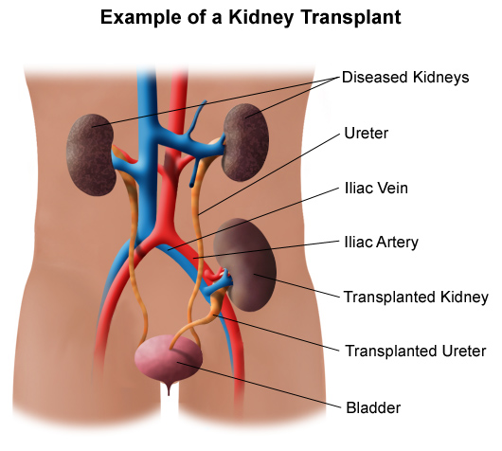
Kidney Transplant
As a last resort
Involves donor organ from someone with a similar immune system
Main complication - rejection

Slide 23
Definitions
Enuresis | Bedwetting
Glycosuria | Sugar in urine
Nocturia | Frequent urination at night
Polyuria | Large amounts of urine
Pyuria | Pus in urine
Anuria | No urine produced
Hematuria | Blood in urine
Diuretic | Drug or substance to increase urine production

