Slide 1
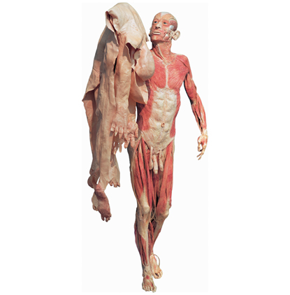
The Integumentary System
Skin, Hair, Glands, & Nails

Slide 2
The Skin
Cutaneous membrane
Waterproof, stretchable, and invisibly repairs cuts, rips, or burns
Functions
Protection
Maintains body temperature
Prevents excessive loss of inorganic & organic materials
Receives stimuli
Stores chemical compounds
Synthesizes vitamin D
Excretes water, salts, & several organic compounds

Slide 3
Structure of the Skin
Composed of two layers of tissue
Epidermis
Outer layer composed of squamous epithelium
Dermis
Underlying layer composed of dense connective tissue
The epidermis & dermis are fully cemented together
Skin is anchored to the underlying organs by the subcutaneous layer (Adipose Tissue)
Acts as a shock absorber & insulation

Slide 4
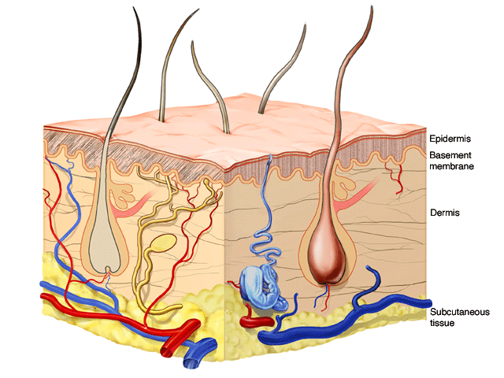

Slide 5
The Epidermis
Epidermis Layers from deepest to the surface
Stratum Basale (Germinativum)
Stratum Spinosum
Stratum Granulosum
Stratum Lucidum
Stratum Corneum
The germinativum & spinosum undergo continual cell division & produce all the other layers
As cells move toward the surface, they become flatter, increasingly full of keratin (harden) & finally die
Can no longer get adequate nutrients & oxygen from the dermis

Slide 6
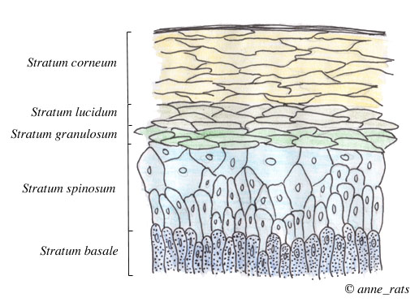

Slide 7
The Dermis
Two major regions:
Papillary Area
Upper dermal region
Contains finger-like projections (dermal papillae) that indent the epidermis above
Dermal papillae bring nutrients to the epidermis
Reticular Area – deepest skin layer
Contains blood vessels, sweat & oil glands, & deep pressure sensors
Contains collagen & elastic fibers
Varies in thickness depending on the locations on the body

Slide 8
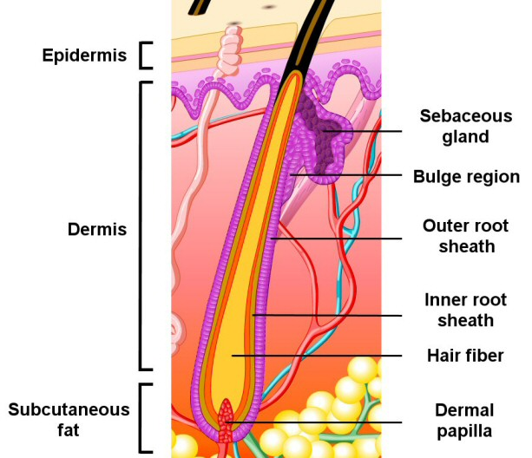
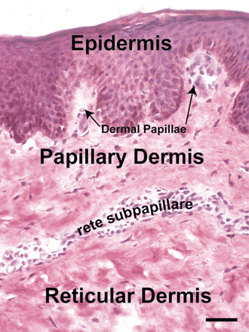

Slide 9
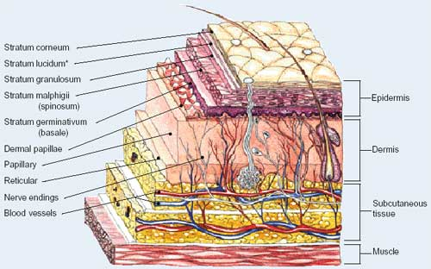

Slide 10
Skin Color
Determined by 3 pigments
Melanin
Brown & black pigment
Found in the epidermis
Produced by melanocytes
Acts as protection from UV rays
Carotene
Orange-yellow pigment
Hemoglobin
Blood in the capillaries of the dermis
Pigment in red blood cells – “rosy” skin tone

Slide 11
Alteration of Skin Color
Blue Color
Indicates cyanosis: poor oxygenation
Heart failure & severe breathing
Redness or Erythema
Indicates embarrassment, fever, hypertension, inflammation, or allergy
Pallor or blanching
Indicates fear, anger, or emotional stress
Also anemia, low blood pressure, or impaired blood flow
Jaundice or a yellow cast
Signifies a liver disorder due to excess bile

Slide 12
Skin Appendages
These appendages come from the epidermis and help maintain the body’s homeostasis.
Cutaneous (relating to skin) glands
Sebaceous glands
Sweat glands
Hair
Hair follicles
Nails

Slide 13
Appendages of the Skin
Sebaceous glands
Produce oil
Lubricant for skin which keeps skin soft and moist
Prevents brittle hair
Kills bacteria (slightly acidic)
Most have ducts that empty into hair follicles; others open directly onto skin surface
Glands are activated at puberty and this is what causes teenage acne

Slide 14
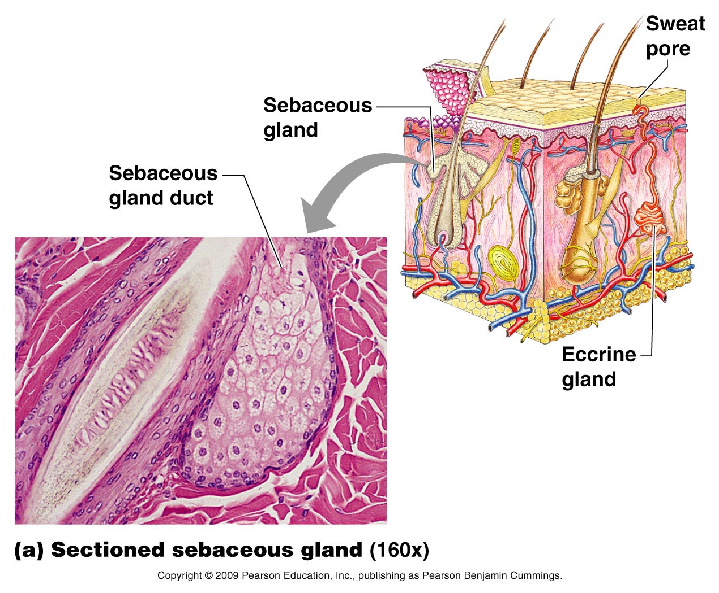
Appendages of the Skin

Slide 15
Facial Blemishes
Whitehead – sebaceous gland is blocked usually from the oily substance made by the gland.
Blackhead – when whitehead dries, it darkens forming blackhead
Acne – an active infection of the sebaceous glands caused by bacteria

Slide 16
Appendages of the Skin
Sweat glands
Produce sweat
Widely distributed in skin
(2.5 million per person)
helps cool the body
Two types
Eccrine
Open via duct to pore on skin surface
Most numerous on the body
Apocrine
Ducts empty into hair follicles
Found mostly in armpits and genital areas
Precise function is unknown but are they are activated during pain, stress and during sexual foreplay.

Slide 17
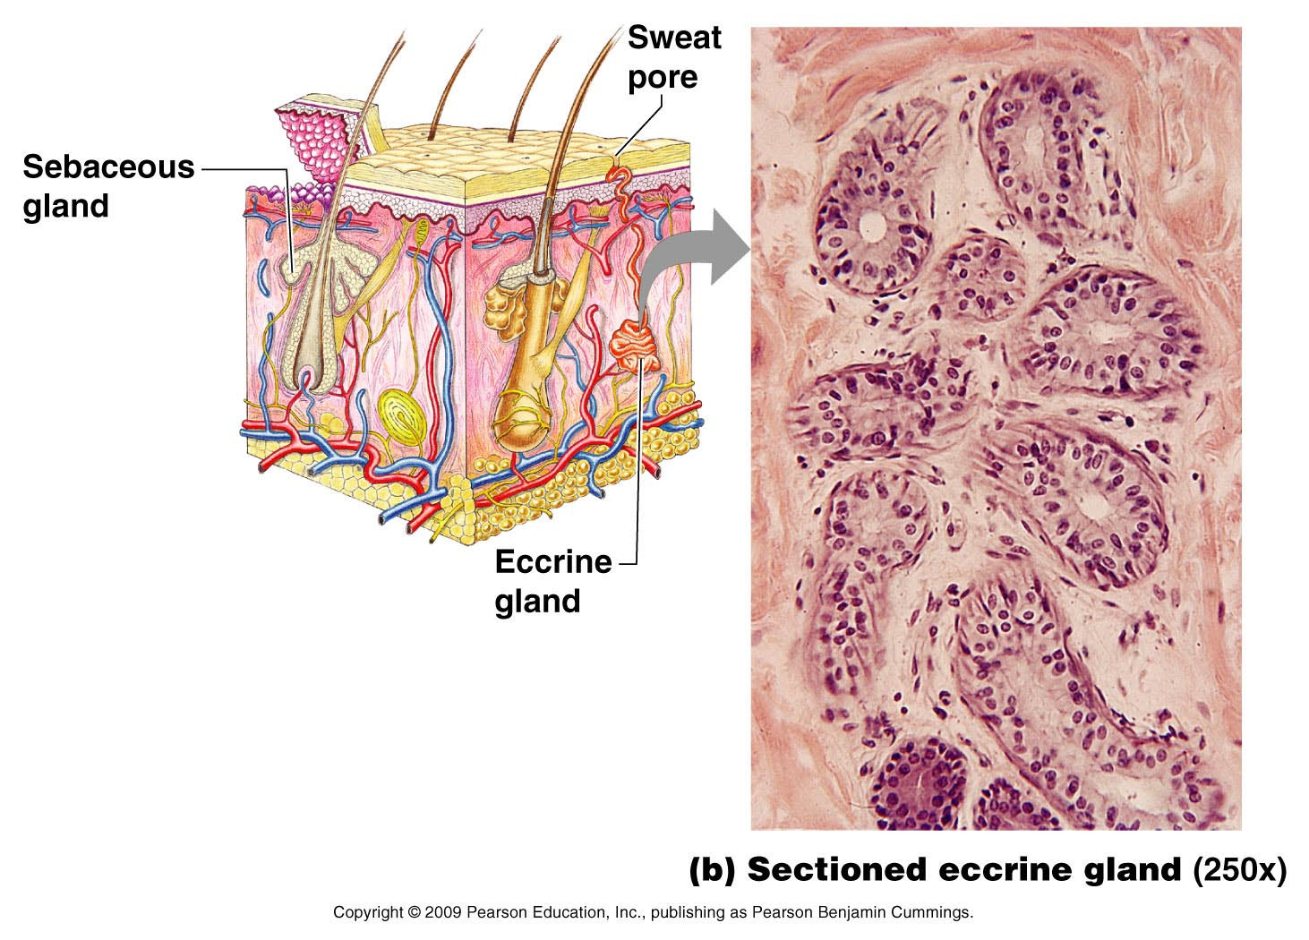
Appendages of the Skin

Slide 18
Sweat and Its Function
Composition
Mostly water
Salts and vitamin C
Some metabolic waste (urea and uric acid)
Fatty acids and proteins (apocrine only)
Function
Helps rid body of excess heat
Excretes waste products
Acidic nature inhibits bacteria growth
Odor is from associated bacteria

Slide 19
Appendages of the Skin
Hair
Produced by hair follicle which are made of hard keratinized epithelial cells
Melanocytes provide pigment for hair color

Slide 20
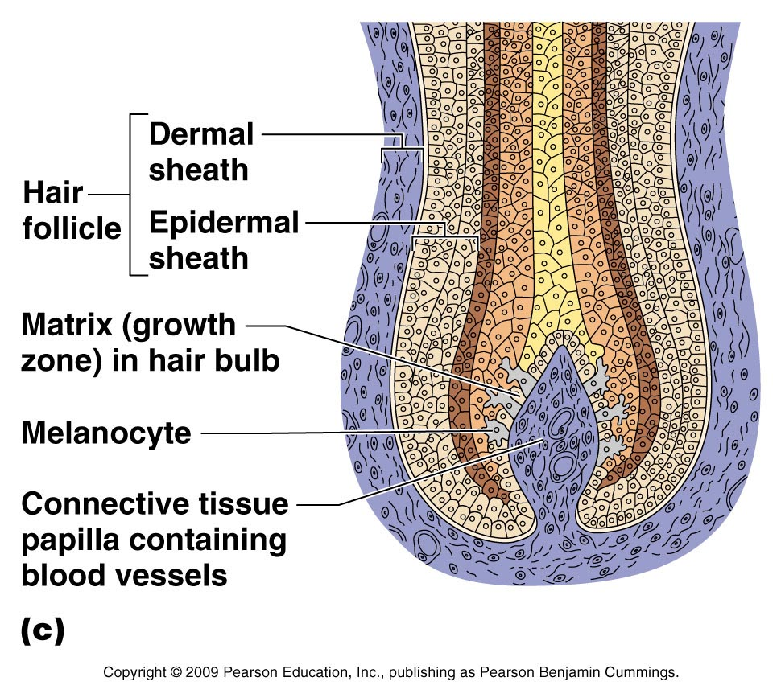
Structure of Hair Follicle

Slide 21
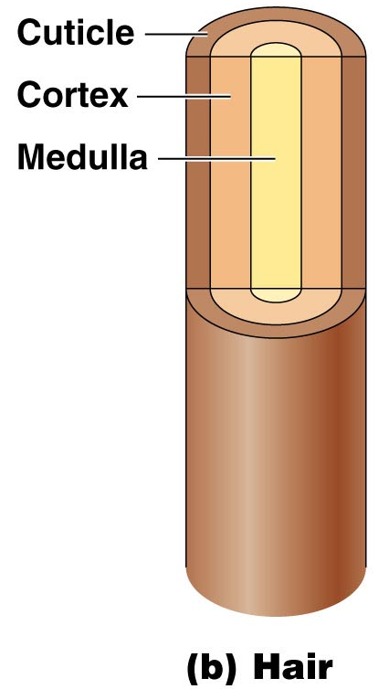
Hair Anatomy
Hair anatomy
Central medulla
Cortex surrounds medulla
Cuticle on outside of cortex
Most heavily keratinized

Slide 22
Hair Structures
Associated hair structures
Hair follicle
Dermal and epidermal sheath surround hair root
Arrector pili muscle
Smooth muscle
Pulls hairs upright when cold or frightened
Sebaceous gland

Slide 23
Nails
Nails
Scale-like modifications of the epidermis
Heavily keratinized
Stratum basale extends beneath the nail bed
Responsible for growth
Lack of pigment makes them colorless

Slide 24
Nail Anatomy
Nail structures
Free edge
Body is the visible attached portion
Root of nail embedded in skin
Cuticle is the proximal nail fold that projects onto the nail body

Slide 25
Severity of Burns
First-degree burns
Only epidermis is damaged
Skin is red and swollen
Second-degree burns
Epidermis and upper dermis are damaged
Skin is red with blisters
Third-degree burns (worst)
Destroys entire skin layer
Burn is gray-white or black

Slide 26
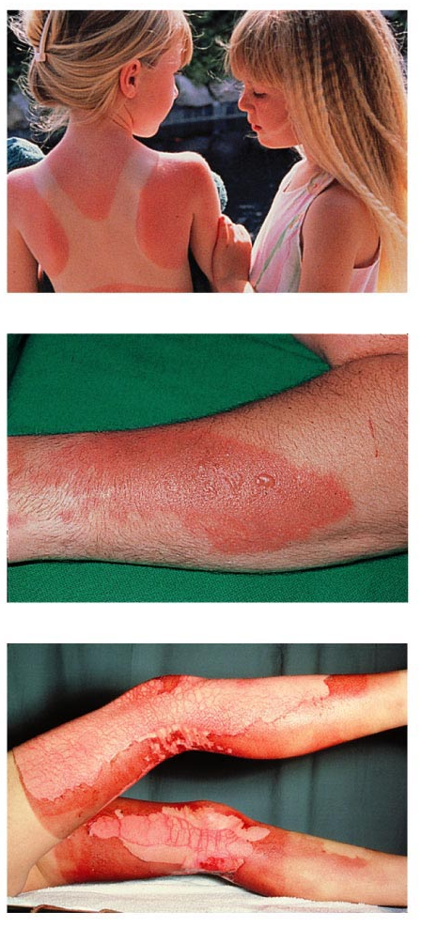
Severity of Burns

Slide 27
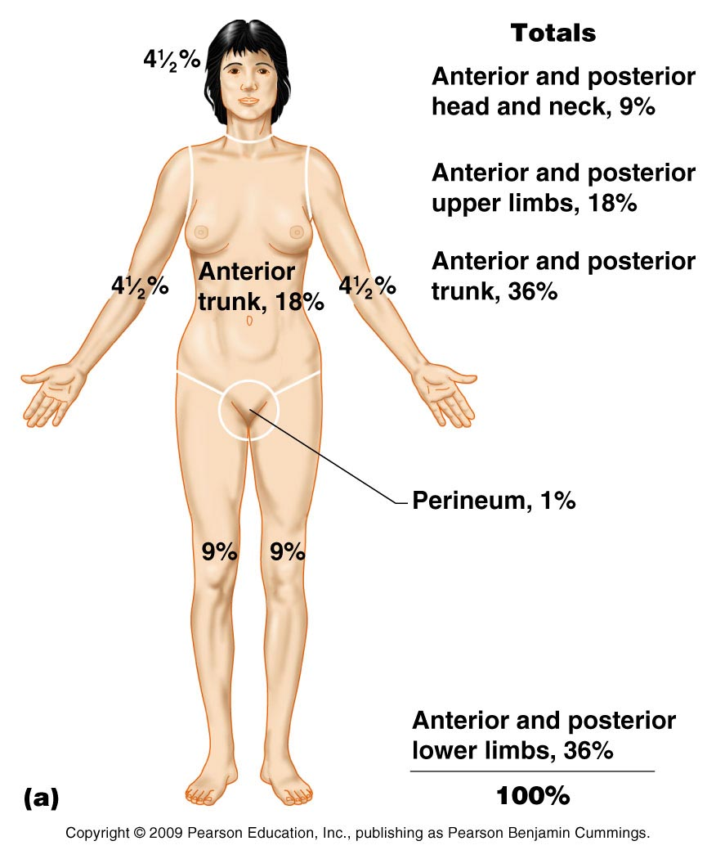
Rule of Nines
Way to determine the extent of burns
Body is divided into 11 areas for quick estimation
Each area represents about 9% of total body surface area

Slide 28
Skin Cancer Types
Basal cell carcinoma
Malignant tumor of the basal cell layer of the epidermis
Squamous cell carcinoma
Metastasizes to lymph nodes if not removed
Early removal allows a good chance of cure
Believed to be sun-induced
Arises from stratum spinosum

Slide 29
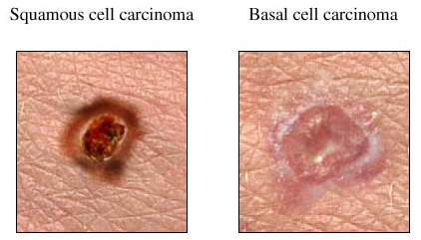
Skin Cancer Types

Slide 30
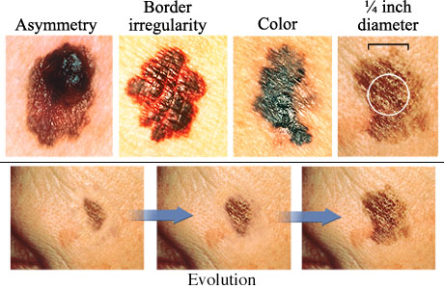
Skin Cancer Types
Malignant melanoma
Cancerous growth composed of melanocytes

