Slide 1
Reproductive Systems
Male & Female

Slide 2
Function
To ensure survival of the species
To produce egg and sperm cells
To transport and sustain these cells
To nurture the developing offspring
To produce hormones
Other systems strive to maintain a state of homeostasis

Slide 3
Male & Female
Include:
Reproductive organs called gonads that produce gametes (reproductive cells) and hormones
Ducts that transport gametes
Accessory glands and organs that secrete fluids

Slide 4
Male & Female
Production of hormones that permit the secondary sex characteristics, such as breast development in women and beard growth in men

Slide 5
Male
Functions
To produce, maintain and transport sperm (the male reproductive cells) and protective fluid (semen)
To produce and secrete male sex hormones responsible for maintaining the male reproductive system

Slide 6
Male
Consists of:
A pair of testes
A network of excretory ducts
epididymis
vas deferens
ejaculatory ducts
Seminal vesicles
Prostate
Urethra
Penis

Slide 7
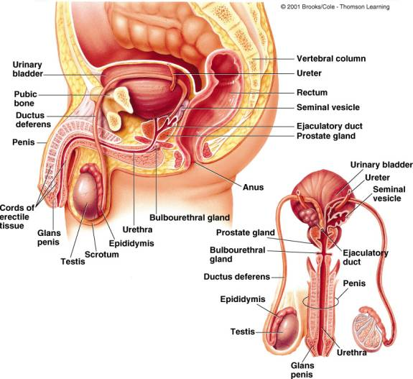
http://www.uh.edu/~tgill2/image010.jpg

Slide 8
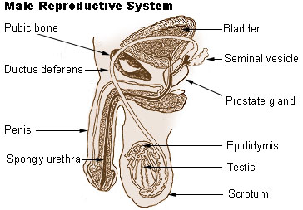
Male
Testes / testicles (Gonads)
Produce sperm (Spermatogenesis)
Sperm production begins at puberty and continues throughout the life of a male

Slide 9
Male
Testes / testicles (Gonads)
Produce testosterone
Hair patterns and voice changes
Development of the male accessory organs (prostate, seminal vesicles etc.)
Stimulates the effect of protein building in the body that is responsible for the greater muscle development and strength of the male

Slide 10
Male
Duct System
Epididymis
Sperm mature in epididymis
Vas Deferens
Transports mature sperm to the urethra
Ejaculatory ducts
empty into the urethra

Slide 11
Male
Seminal vesicles
Attached to vas deferens
Produce a sugar-rich fluid (fructose) that provides energy to sperm

Slide 12
Male
Prostate Gland
Makes fluid

Slide 13
Male
Urethra
Tube that carries urine from the bladder to outside of the body
Also carries semen out of the body

Slide 14
Female
Functions
Produces the female egg cells
Transports the eggs to the site of fertilization
The fertilization of an egg by a sperm, occurs in the fallopian tubes

Slide 15
Female
Functions
After fertilization, provides a place for a baby to develop
If fertilization does not take place, the system is designed to menstruate
Produces female sex hormones that maintain the reproductive cycle.

Slide 16
Female
Consists of:
Vagina
Uterus
Ovaries
Fallopian tubes

Slide 17
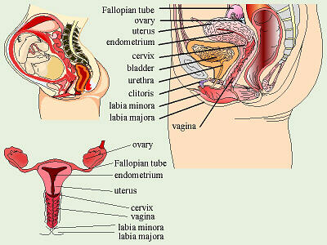
http://biology.clc.uc.edu/graphics/bio105/repro%20female.jpg

Slide 18
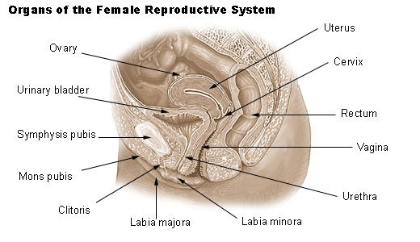
Female
Vagina
Canal that joins the cervix (the lower part of uterus) to the outside of the body
Also is known as the birth canal

Slide 19
Female
Uterus
Hollow, pear-shaped organ that is the home to a developing fetus
Divided into two parts:
the cervix, the lower part that opens into the vagina
Main body of the uterus, called the corpus.
The corpus can easily expand to hold a developing baby.
A channel through the cervix allows sperm to enter and menstrual blood to exit

Slide 20
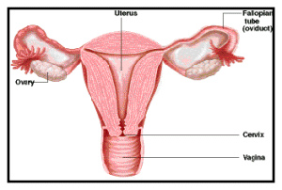
Female
Ovaries
Oval-shaped glands that are located on either side of the uterus
Produce eggs and hormones.
http://www.ricancercouncil.org/img/cervical.gif

Slide 21
Female
Fallopian Tubes
Narrow tubes that are attached to the upper part of the uterus and serve as tunnels for the egg cell to travel from the ovaries to the uterus
Fertilization of an egg by a sperm, normally occurs in the fallopian tubes
The fertilized egg then moves to the uterus, where it implants into the lining of the uterine wall
http://www.ricancercouncil.org/img/cervical.gif

Slide 22
Menstrual Cycle
Menarche
Onset of menstruation
Average cycle lasts for 28 days
Divided into four time periods
Days 1-5 (menstrual period)
Discharge of bloody fluids containing disintegrated endometrial cells, glandular secretions, & blood cells
Days 6-12
Repair of the endometrium; growth of the ovum
Days 13 & 14 (ovulatory period)
Follicle ruptures (ovulation) & egg leaves the ovary
Days 15-28
Empty follicle becomes the corpus luteum
Secretes progesterone
Builds up lining of uterus in anticipation of pregnancy
If no fertilization, cycle repeats

Slide 23
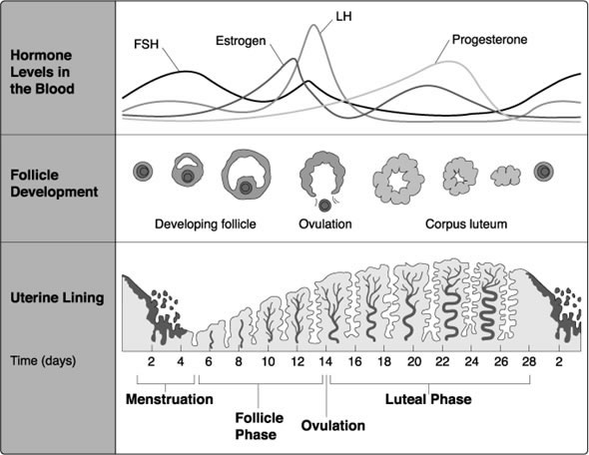

Slide 24
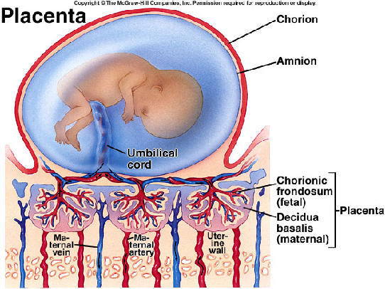
Pregnancy
Fertilized egg travels & implants in the uterine endometrium
Placenta forms within uterine wall
Develops from the chorion
Amnion
Holds the fetus
suspended in an
amniotic cavity
surrounded by
amniotic fluid

Slide 25
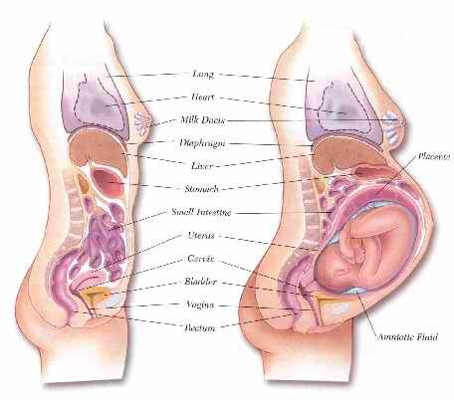

Slide 26
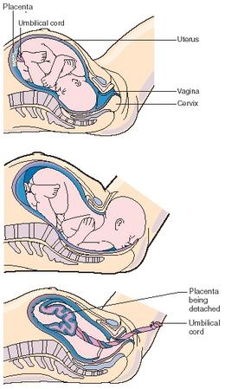
Labor & Delivery
Labor
Marked by rhythmic contractions
Dilation of the cervix
Discharge of bloody mucus
From the cervix & vagina (the “show”)
Normal delivery
Cephalic presentation (baby’s head appears first)
vaginal delivery of baby
Placenta delivery (afterbirth)
Umbilical cord is cut

Slide 27
http://www.youtube.com/watch?feature=player_embedded&v=Xath6kOf0NE

