Slide 1
DNA & Heredity
Chapter 11

Slide 2
Evidence that the Gene is DNA
It was in the right place
nucleus
It varied among species
Each species has its own nuclear DNA
It was present in the right amounts
Somatic cells had twice the amount of DNA than reproductive cells

Slide 3
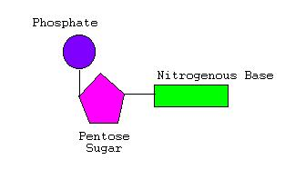
DNA Structure
Nucleotide consist of:
Sugar: deoxyribose
Phosphate group
Nitrogen-containing base
adenine (A) and guanine (G)
cytosine (C) and thymine (T)

Slide 4
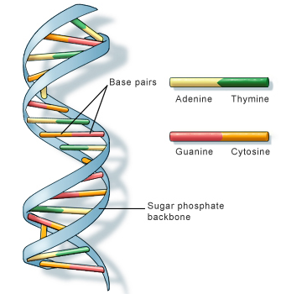
Watson & Crick
Determined that the DNA molecule is helical
Two DNA chains run in opposite directions (antiparallel)
3 key features
Double-stranded helix
Right-handed
Antiparallel

Slide 5
https://www.youtube.com/watch?v=5qSrmeiWsuc

Slide 6
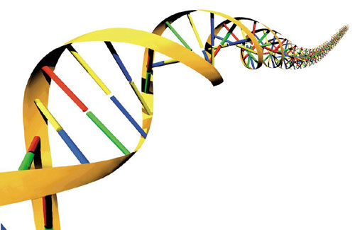
The Helix
Sugar-phosphate are the “backbones”
Nitrogenous bases point toward the center
Held together by hydrogen bonds
Known as complementary base pairing

Slide 7
DNA structure
Structure is essential to DNA function
stores an organism’s genetic information
susceptible to mutation
precisely replicated
expressed as the phenotype
DNA is copied to RNA, converted to amino acids – protein.
Folded forms of protein provide the phenotype of an organism

Slide 8
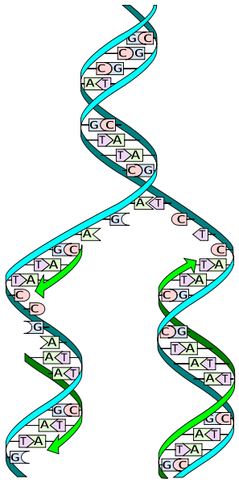
DNA Replication
Two steps
DNA double helix is unwound to separate the strands
New nucleotides are joined to each growing new strand

Slide 9
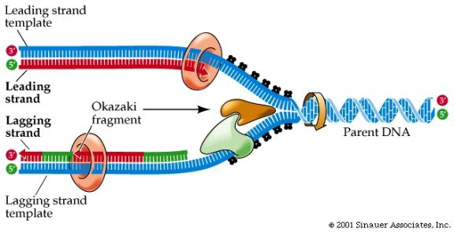
DNA Replication
DNA helicase
Unwinds the DNA
Single-strand binding proteins
Bind to the unwound strands to prevent reassociating the double helix

Slide 10
DNA Replication
DNA polymerase
Adds nucleotides to the growing chain
The two DNA strands grow differently
Leading strand
Follows the helicase
Lagging strand
Moving in the “wrong” direction; replicates DNA in fragments (Okazaki fragments)
DNA ligase links the fragments to make them whole.

Slide 11
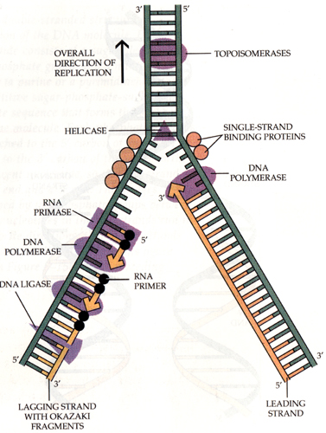

Slide 12
https://www.youtube.com/watch?v=dKubyIRiN84

