Slide 1
Ch. 3 Body Structures
Audionyms

Slide 2
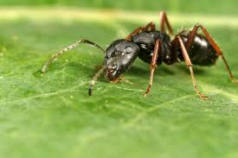
Anti-
Audionym
Ant eye
Visual Image
See the ANT with the EYE AGAINTS the leaf
Meaning
against

Slide 3
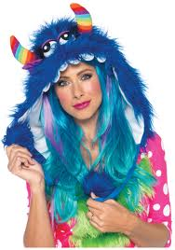
Blephar-
Audionym
Blue fur
Visual image
See the lady wearing BLUE FUR with EYELIDS
Meaning
eyelid

Slide 4
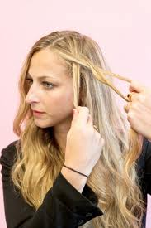
Brady-
Audionym
Braid
Visual Image
See the girl’s hair being BRAIDED so SLOWLY
Meaning
slow

Slide 5
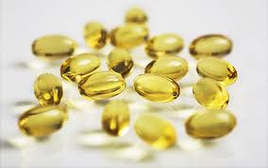
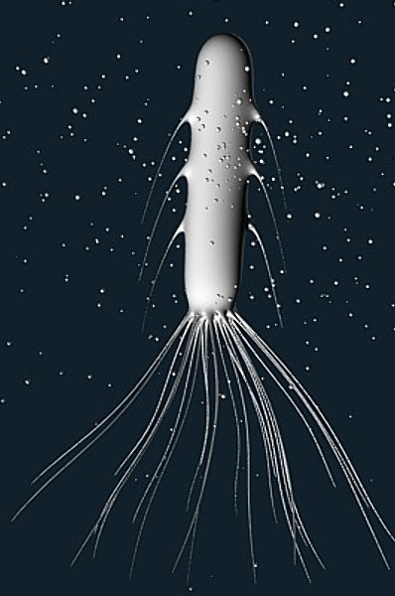
Cauda- Caud(o)
Audionym
Cod liver oil
Visual Image
See the COD LIVER OIL with TAILS coming out of it
Meaning
Tail

Slide 6
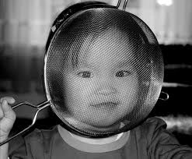
Cephal(o)
Audionym
Sieve fall
Visual Image
See the SIEVE FALLING with a HEAD in it
Meaning
head

Slide 7
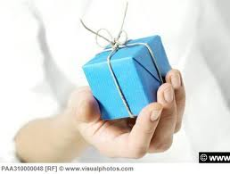
Chir(o)
Audionym
Care (package)
Visual Image
See the CARE package held by the HAND
Meaning
hand

Slide 8
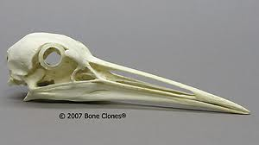
Crani(o)
Audionym
Crane
Visual Image
See the sandhill CRANE’s SKULL
Meaning
skull

Slide 9
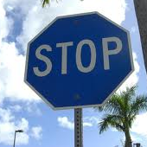
Cyan(o)
Audionym
Sign
Visual Image
See the stop SIGN with BLUE paint poured on it
Meaning
blue

Slide 10
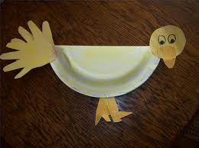
Dactyl-
Audionym
Duck tail
Visual Image
See the DUCK TAIL made out of FINGERS & TOES
Meaning
Finger, toe

Slide 11
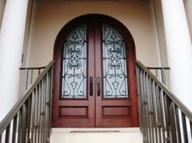
Dors-
Audionym
Doors
Visual Image
See the double DOORS going BACK outside
Meaning
back

Slide 12
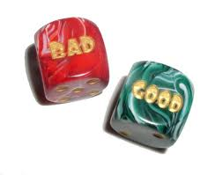
Dys-
Audionym
Dice
Visual Image
See the DICE with BAD written on it
Meaning
Bad, out of order

Slide 13
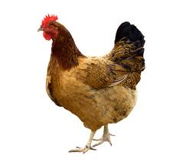
En-
Audionym
Hen
Visual Image
See the HEN saying “they won’t let me IN the INN”
Meaning
in

Slide 14
Encephal-
Audionym
Hen sieve fall
Visual Image
See the HEN FALLING into the SIEVE. It has a BRAIN instead of a head
Meaning
brain

Slide 15
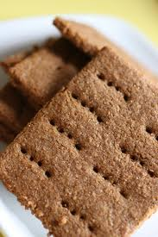
Gram(o) -gram
Audionym
Graham cracker
Visual Image
See the RECORD made of a GRAHAM cracker
Meaning
Record, write

Slide 16
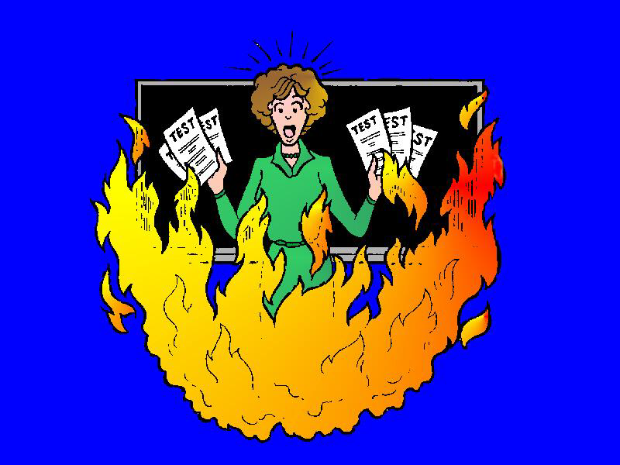
-itis
Audionym
I test
Visual Image
I TEST IN FLAMES
Meaning
Inflammation

Slide 17
Infer-
Audionym
Inn, fur
Visual Image
See the INN, FUR (an inn made of fur) UNDER water
Meaning
under

Slide 18
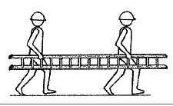
Later-
Audionym
Ladder
Visual Image
See a LADDER with the men carrying it from the SIDE
Meaning
side

Slide 19
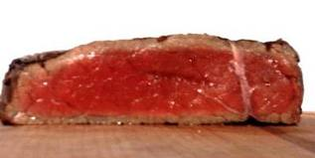
Medi(o) med-
Audionym
Meat
Visual Image
See the MEAT that’s still red in the MIDDLE
Meaning
middle

Slide 20
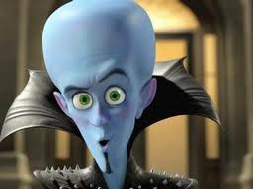
Mega-
Audionym
Mega(mind)
Visual Image
See MEGAmind with the LARGE head
Meaning
Large

Slide 21
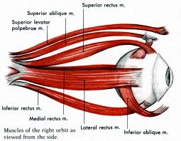
My(o)
Audionym
My eye
Visual Image
See MY eye with MUSCLES
Meaning
Muscles

Slide 22
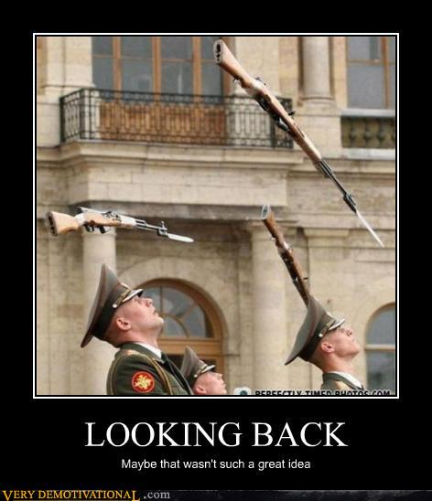
Poster-
Audionym
Poster
Visual Image
See the POSTER with everyone looking BACK
Meaning
Back part

Slide 23
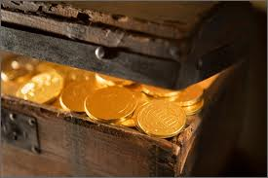
Thorac(o)
Audionym
Throw rack
Visual Image
See the man THORWING a RACK attached to a treasure CHEST
Meaning
Chest

Slide 24
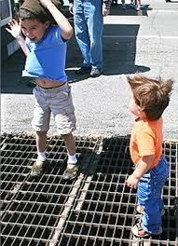
Ventr(o)
Audionym
Vent
Visual Image
See the VENT blowing to see the FRONT & BELLY of the child
Meaning
Front , belly

