Slide 1
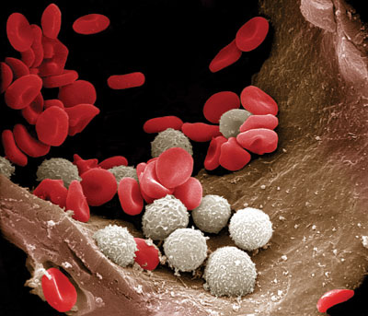
Blood System

Slide 2
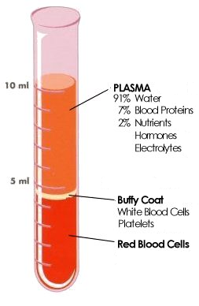
Composition & Formation of Blood
45% of blood volume
Erythrocytes (red blood cell)
Leukocytes (white blood cell)
Platelets
Or thrombocytes (clotting cells)
55% of blood volume
Plasma
Solution of water, proteins, sugar, salts, hormones & vitamins

Slide 3
Cells
Originate in the marrow cavity of bones
Arise from hematopoietic stem cells
Erythrocytes
From erythroblast to erythrocyte, the RBC loses it nucleus & assumes the shape of a biconcave disk
Allows large surface area
Contain hemoglobin
Heme (iron-containing pigment)
Globin (protein)
Allows erythrocyte to carry oxygen
Live ~120 days
Macrophages destroy worn-out RBC
Process called hemolysis

Slide 4
Cells
Leukocytes
Less numerous than erythrocytes
Play important role in the immune response
Directly attack foreign matter
Make antibodies
Neutralize & lead to the destruction of foreign antigens
Some mover into tissues as macrophages & dispose of dead cells by phagocytosis

Slide 5
Cells
Platelets (Thrombocytes)
Formed by megakaryocytes
Giant cells with multilobed nuclei
Main function: help blood to clot
Plasma
Liquid part
Water, dissolved proteins, sugar, wastes, salts, hormones, & other substances

Slide 6
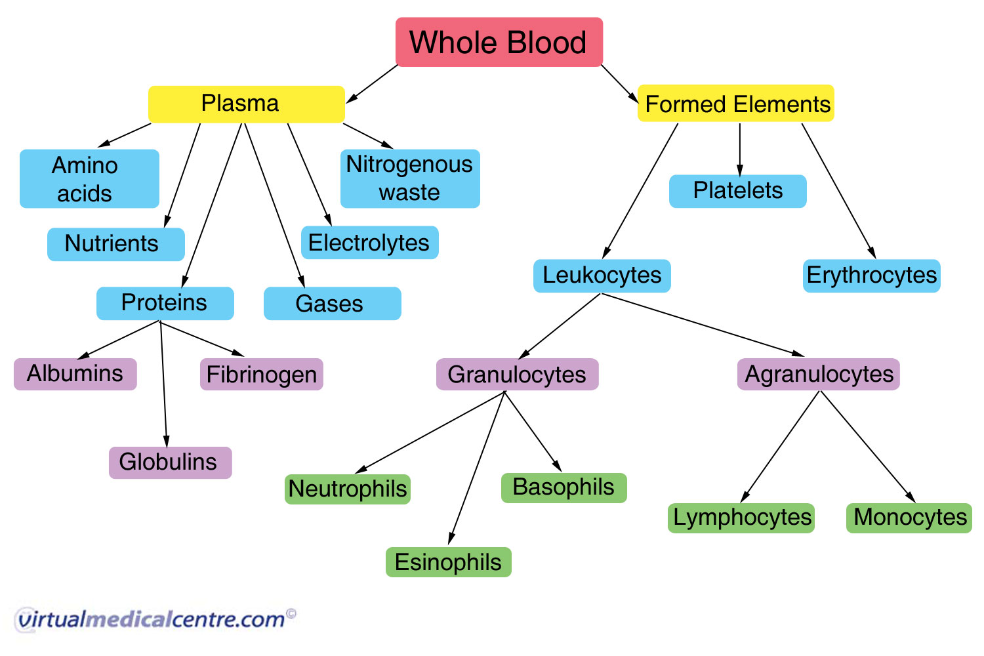

Slide 7
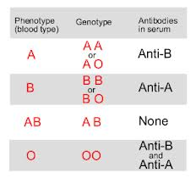
Blood Types
Four main types
A, B, AB, & O
Based on the antigens on RBC & antibodies found in each person’s serum
Rh Factor
One of the many other antigens found on the surface of RBC
Rh+ refers to one born with the Rh antigen
Rh- refers to one born without the Rh antigen

Slide 8
Blood Clotting
Coagulation
Blood clotting
Complicated process involving many different substances & chemical reactions
Final result is the formation of a fibrin clot
From the plasma protein fibrinogen
Anticoagulant substances
Inhibit blood clotting
Ex. Heparin

Slide 9
Pathology
Anemia
Deficiency in erythrocytes or hemoglobin
Hemolytic anemia
Reduction in red cells due to excessive destruction
Hemophilia
Excessive bleeding caused by hereditary lack of blood clotting
Leukemia
Increase in cancerous white blood cells

Slide 10
Audionyms

Slide 11
Aer(o)
Audionym
Air (plane)
Visual Image
See the AIRplane flying through the AIR
Meaning
air

Slide 12
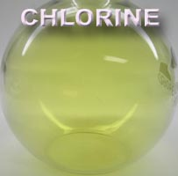
Chlor(o)
Audionym
Chlor(ine)
Visual Image
See the CHLORine…it is GREEN
Meaning
Green

Slide 13
Cyt-
Audionym
Sight
Visual Image
See the SIGHT of the gun in the CELL
Meaning
cell

Slide 14
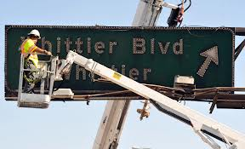
-ectomy
Audionym
Exit Tommy
Visual Image
See TOMMY “CUTTING OUT” (removing) the EXIT sign
Meaning
Surgical removal of all or part of

Slide 15
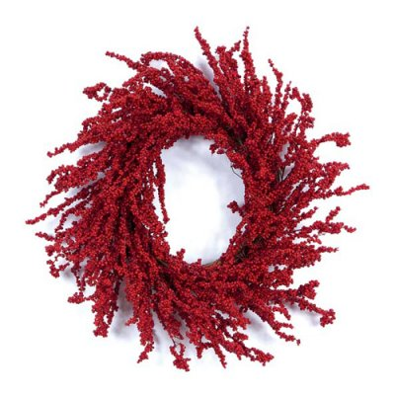
Erythro-
Audionym
Wreath throw
Visual Image
See the WREATH being thrown. It is RED
Meaning
red

Slide 16
Hem(a), hem(o), hemat(o)
Audionym
Hem
Visual Image
See the HEM with BLOOD all over it
Meaning
blood

Slide 17
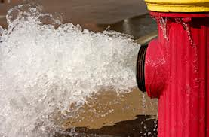
Hydr(o)-
Audionym
Hydrant
Visual Image
See the HYDRANT with WATER gushing out
Meaning
water

Slide 18
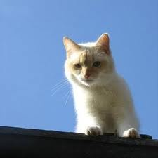
Hyper-
Audionym
High purr
Visual Image
See the cat HIGH-PURRING ABOVE a MORE THAN NORMAL EXCESSIVE amount of noise
Meaning
Above, excessive, more than normal

Slide 19
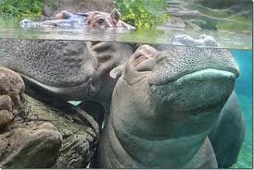
Hypo-
Audionym
Hippo
Visual Image
See the deficient HIPPO UNDER, BENEATH the water
Meaning
Under, beneath, deficient

Slide 20
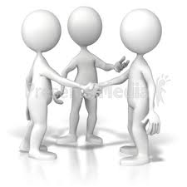
Intra-
Audionym
Introduce
Visual Image
See the man being INTRODUCED to the man WITHIN the other man
Meaning
Within

Slide 21
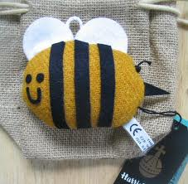
Inter-
Audionym
Interpreter
Visual Image
See the INTERpreter. It is a BEE in TWEED
Meaning
between

Slide 22
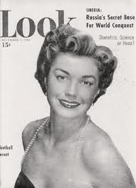
Leuk(o)
Audionym
Look (magazine)
Visual Image
See the LOOK magazine which is all WHITE
Meaning
white

Slide 23
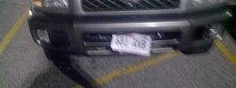
-lysis
Audionym
License
Visual Image
See the LICENSE LOOSENING & being destroyed
Meaning
Loosening, destruction, set free

Slide 24
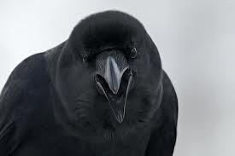
Macr(o), Megal(o)
Audionym
My crow
Visual Image
See MY CROW as the most ENLARGED crow in the world
Meaning
enlarged

Slide 25
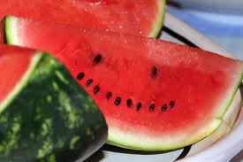
Melan-
Audionym
Melon
Visual Image
See the MELON with the BLACK seeds inside
Meaning
black

Slide 26
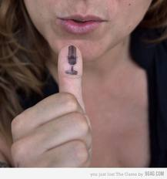
Micro-
Audionym
Microphone
Visual Image
See the MICRophone so SMALL it’s the size of a thumb
Meaning
small

Slide 27
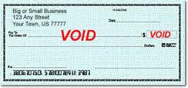
-oid
Audionym
Void
Visual Image
See the VOIDed checks with look ALIKE, RESMEBLING each other
Meaning
Like, resembling

Slide 28
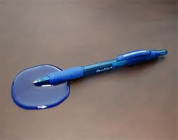
-penia
Audionym
Pen
Visual Image
See the PEN DECREASING its ink
Meaning
decrease

Slide 29
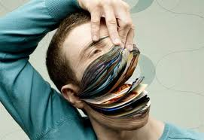
Phag(o)
Audionym
Page
Visual Image
See the PAGE used for EATING
Meaning
To eat

Slide 30
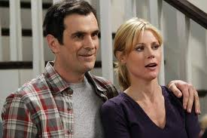
Phil(o)
Audionym
Phil (man’s name)
Visual Image
See PHIL’s ATTRACTION to his wife
Meaning
Attraction

Slide 31
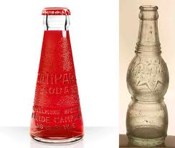
Poikil(o)
Audionym
Pour a kilo (liters)
Visual Image
See the man POUR a KILOliter into an IRREGULAR bottle
Meaning
Irregular

Slide 32
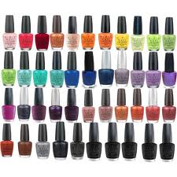
Poly-
Audionym
Polish
Visual Image
See the nail POLISH with many, many colors
Meaning
Many or much

Slide 33
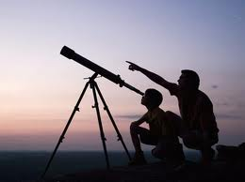
Scop
Audionym
Scope
Visual Image
See the teleSCOPE with everyone LOOKing at it and OBSERVING it
Meaning
Look, observe

Slide 34
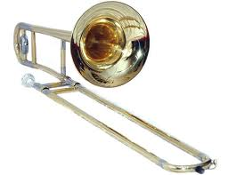
Thromb-
Audionym
Trombone
Visual Image
See the TROMBONE with a LUMP or a CLOT in it
Meaning
Lump, clot

Slide 35
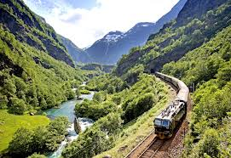
Trans-
Audionym
Trains
Visual Image
See the TRAIN going THROUGH and ACROSS the mountain
Meaning
Through, across, beyond

Slide 36
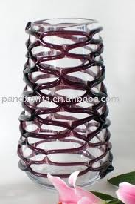
Vaso-, Vascul(o)
Audionym
Vase
Visual Image
See the VASE with VESSELS on it
Meaning
Vessel

