Slide 1
Audionyms
PRONOUNCE the ELEMENT
THINK of the AUDIONYM (sound alike)
PICTURE the ILLOGICAL ASSOCIATION
REMEMBER the actual MEANING

Slide 2
Algesi(o) -algia
Audionym
Algae
Visual Image
See the ALGAE on the lake through the window PANE
Meaning
Pain, painful condition

Slide 3
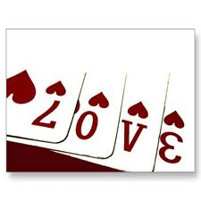
Cardi-
Audionym
Card
Visual Image
See the people playing CARDS with live HEARTS
Meaning
heart

Slide 4
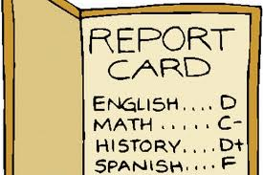
An- A-
Audionym
An a
Visual Image
See the student’s report card WITHOUT AN A, NOT one A
Meaning
Without, not

Slide 5
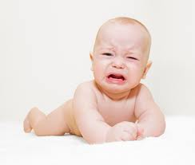
-crine
Audionym
Cry’n
Visual Image
See the person CRY’N TO SEE the CRATE
Meaning
To secrete

Slide 6
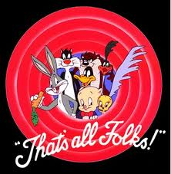
End- Endo-
Audionym
The end
Visual Image
See the END of the motion picture loony toons INSIDE or WITHIN the screen
Meaning
Inside, within

Slide 7
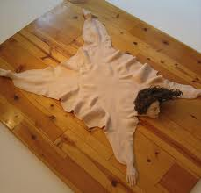
Dermat-
Audionym
Doormat
Visual Image
See the DOORMAT made of SKIN
Meaning
skin

Slide 8
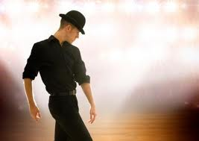
Esthesi-
Audionym
Has the show
Visual Image
See the man who HAS THE SHOW, he is SENSATIONAL
Meaning
Sensation, feeling

Slide 9
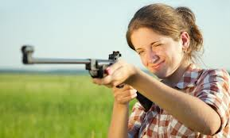
Gyn- gynec-
Audionym
Gun
Visual Image
See the GUN the FEMALE is holding.
Meaning
female

Slide 10
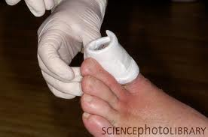
Histo-
Audionym
His toe
Visual Image
See HIS TOE with TISSUES coming out of it
Meaning
tissue

Slide 11
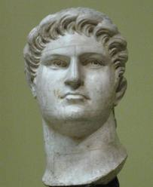
Neuro-
Audionym
Nero
Visual Image
See NERO being very NERVOUS as Rome burns
Meaning
Nerve (nervous system)

Slide 12
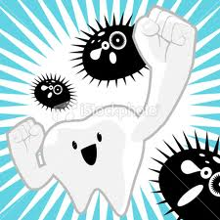
Odont- Dent
Audionym
Oh don’t
Visual Image
See the man saying, “OH DON’T hit me with that TOOTH”
Meaning
tooth

Slide 13
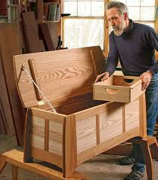
-ologist
Audionym
Hollow chest
Visual Image
See the man with the HOLLOW CHEST for books: he is a SPECIALIST
Meaning
A specialist in the study of

Slide 14
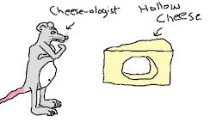
-ology
Audionym
Hollow cheese
Visual Image
See the HOLLOW CHEESE with the people make a STUDY OF it
Meaning
Study of

Slide 15
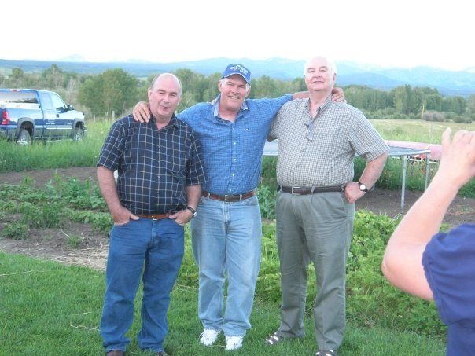
Onco-
Audionym
Uncle
Visual Image
See the UNCLE being introduced; there are TWO MORE
Meaning
Mass, tumor or swelling

Slide 16
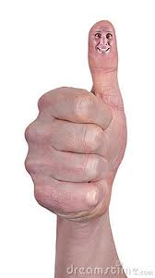
Ophthalm- opt-
Audionym
Up thumb
Visual Image
See the UP THUMB (thumbs up) with an EYE on top
Meaning
eye

Slide 17
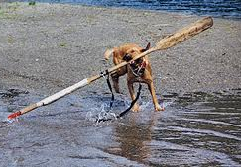
Or-
Audionym
Oar
Visual Image
See the dog holding the OAR in the MOUTH
Meaning
Mouth

Slide 18
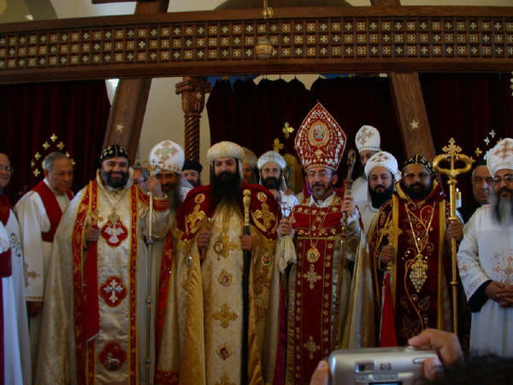
Orth
Audionym
Orthodox church
Visual Image
See the ORTHodox church with workmen trying to make it STRAIGHT
Meaning
straight

Slide 19
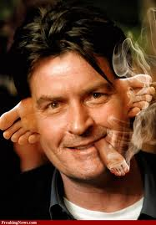
Oto-
Audionym
“O” toe
Visual Image
See the “O” TOES for EARS
Meaning
ear

Slide 20
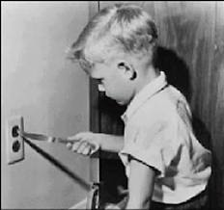
-Otomy -tomy
Audionym
Oh Tommy!
Visual Image
See Tommy’s mother saying, “OH TOMMY! You CUT INTO the wall!”
Meaning
Cut into, incision, into

Slide 21
Path
Audionym
Path
Visual Image
See the PATH with DAISIES growing on it
MEANING
disease

Slide 22
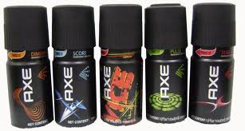
Pharmac-
Audionym
Farm axe
Visual Image
See the FARMER with the “FARM AXE” sold at the DRUGstore
Meaning
Drug

Slide 23
Physio-
Audionym
Physics
Visual Image
See the NATURE boy streaking out of the PHYSICS book
Meaning
nature

Slide 24
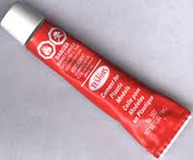
Plast-
Audionym
Plastic (cement)
Visual Image
See the tube of PLASTic cement with the SURGEON coming out to REPAIR something
Meaning
Surgical repair, plastic repair

Slide 25
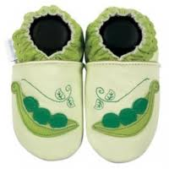
Pod-
Audionym
Pod
Visual Image
See the FOOT in the POD instead of peas
Meaning
foot

Slide 26
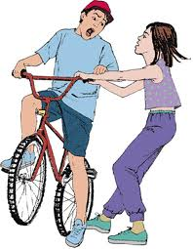
Psycho
Audionym
Cycle
Visual Image
See the people fight over the CYCLE saying “MINE,MINE!”
Meaning
mind

Slide 27
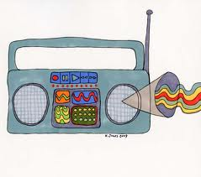
Radi-
Audionym
Radio
Visual Image
See the RADIo with a RAY coming out of it
Meaning
ray

Slide 28
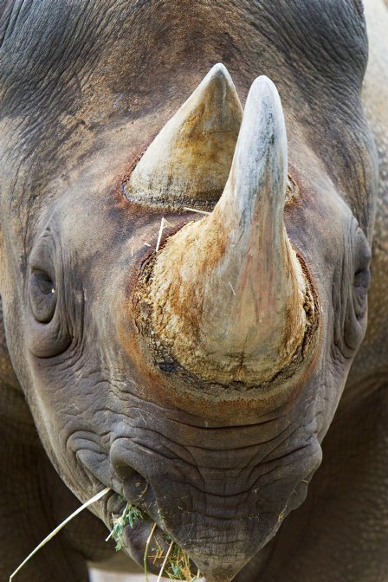
Rhin(o)-
Audionym
Rhino
Visual Image
See the RHINOceros with the massive NOSE
Meaning
Nose

